Slide 1
Decision Structure and Boolean Logic Session 5
Course : COMP6056
Effective Period : September 2021

Slide 2
Sub Topics
Introduction to decision structure
Dual alternative decision structure
Compare string
Nested Decision
Case Structure
Logical Operators
Boolean variables

Slide 3
These slides have been adapted from: Gaddis, T. (2019). Starting Out with Programming Logic and Design 5^{th.} ISBN: 978-0-13-480115-5 Chapter 4
Acknowledgement

Slide 4
Learning Objectives
At the end of this lecture, students are able to:
LO1: To explain the uses of decision structure and Boolean logic
LO2: To write pseudo-code to solve problem containing decisions

Slide 5
Introduction to Decision Structures
A decision structure allows a program to perform actions only under certain conditions
Different types of decisions include
If, also called single alternative
If then else, also called dual alternative
Case structure for multiple alternative decisions
Gaddis, T., Starting Out With Programming Logic and Design, 5 ed, ISBN: 978-0-13-480115-5

Slide 6
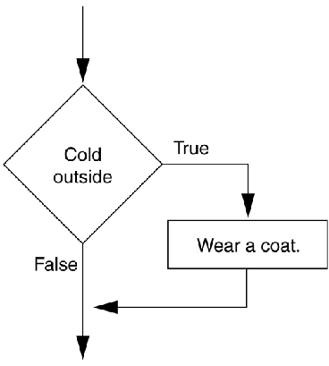
Introduction to Decision Structures
The if statement
An action only occurs if the decision is true
IF condition THEN
Statement
Statement
ENDIF
A diamond symbol is used in flowcharts
Gaddis, T., Starting Out With Programming Logic and Design, 5 ed, ISBN: 978-0-13-480115-5

Slide 7
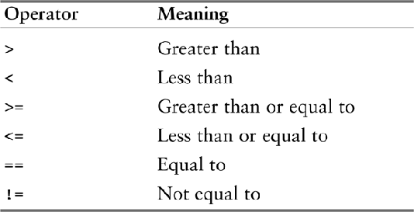
Introduction to Decision Structures
Relational Operators
Determines whether a specific relationship exists between two values
Used within the condition, a Boolean expression
x > y x<y x >=y x<y x <=y x==y x!=y
Relational operators
Gaddis, T., Starting Out With Programming Logic and Design, 5 ed, ISBN: 978-0-13-480115-5

Slide 8
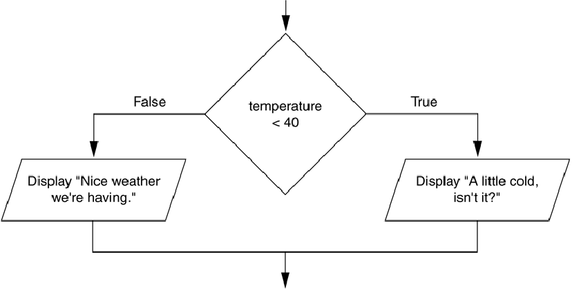
Dual Alternative Decision Structures
If then else statement
Executes one group of statements if it’s Boolean expression is true, or another group if its Boolean expression is false
A dual alternative decision structure
Gaddis, T., Starting Out With Programming Logic and Design, 5 ed, ISBN: 978-0-13-480115-5

Slide 9
Dual Alternative Decision Structures
IF condition THEN
statement
statement
ELSE
statement
statement
ENDIF
IF temperature < 40 THEN
DISPLAY “A little cold”
DISPLAY “Get a coat!”
ELSE
DISPLAY “Nice weather”
DISPLAY “And sunny!”
ENDIF
Gaddis, T., Starting Out With Programming Logic and Design, 5 ed, ISBN: 978-0-13-480115-5

Slide 10
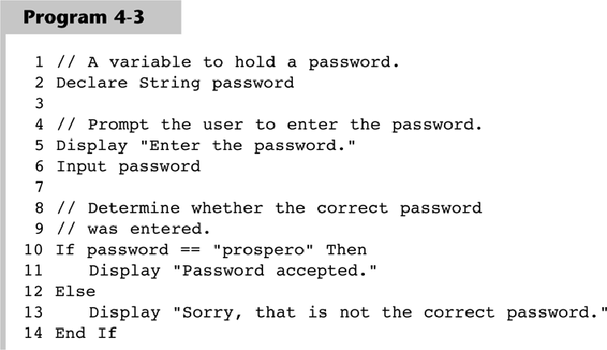
Comparing Strings
Gaddis, T., Starting Out With Programming Logic and Design, 5 ed, ISBN: 978-0-13-480115-5

Slide 11
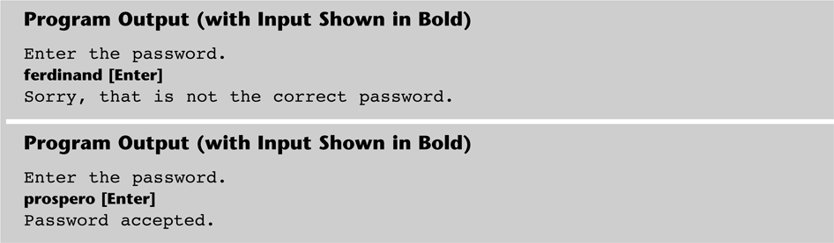
Comparing Strings
Gaddis, T., Starting Out With Programming Logic and Design, 5 ed, ISBN: 978-0-13-480115-5

Slide 12
Comparing Strings
Other String Concerns
String and strings can be compared
name1 == name 2
String and string literals can be compared
Month != “October”
String comparisons are generally case sensitive
You can also determine whether one string is greater than or less than another string (allows for sorting strings)
Gaddis, T., Starting Out With Programming Logic and Design, 5 ed, ISBN: 978-0-13-480115-5

Slide 13
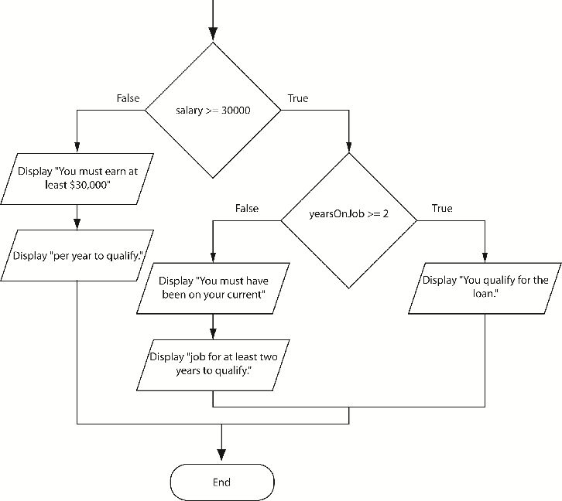
Nested Decision Structures
Decisions are nested in order to test more than one condition
If then if else example
Gaddis, T., Starting Out With Programming Logic and Design, 5 ed, ISBN: 978-0-13-480115-5

Slide 14
Nested Decision Structures
The if then else if statement can make nested logic simpler to write
IF score < 60 THEN
DISPLAY “Grade is F.”
ELSE
IF score < 70 THEN
DISPLAY “Grade is D.”
ELSE
IF score < 80 THEN
DISPLAY “Grade is C.”
ELSE
IF score < 90 THEN
DISPLAY “Grade is B.”
ELSE
DISPLAY “Grade is A.”
ENDIF
Gaddis, T., Starting Out With Programming Logic and Design, 5 ed, ISBN: 978-0-13-480115-5

Slide 15
Algorithm using Selection
Case: Design an algorithm that will prompt a terminal operator for three characters, accept those characters as input, sort them into ascending sequence and output them to the screen
Solution:
A. Defining Diagram
Input | Processing | Output
char_1 char_2 char_3 | Prompt for characters Accept three characters Sort three characters Output three characters | char_1 char_2 char_3

Slide 16
Example (cont’d)
B. Solution Algorithm
The solution algorithm requires a series of IF statements to sort the three characters into ascending sequence
Read_three_characters
1 Prompt the operator for char_1, char_2, char_3
2 Get char_1, char_2, char_3
3 IF char_1>char_2 THEN
temp = char_1
char_1 = char_2
char_2 = temp
ENDIF
4 IF char_2>char_3 THEN
temp = char_2
char_2 = char_3
char_3 = temp
ENDIF
5 IF char_1>char_2 THEN
temp = char_1
char_1 = char_2
char_2 = temp
ENDIF
6 Output to the screen char_1, char_2, char_3
END

Slide 17
Example (cont’d)
C. Desk Checking
Two sets of valid characters will be used to check the algorithm; the characters k ,b , and g as the first and z, s, and a as the second
Input data
2. Expected result

Slide 18
Example (cont’d)
3. Desk check table
Line numbers have been used to identify each statement within the program. Note that when desk checking the logic each IF statement is treated as a single statement .

Slide 19
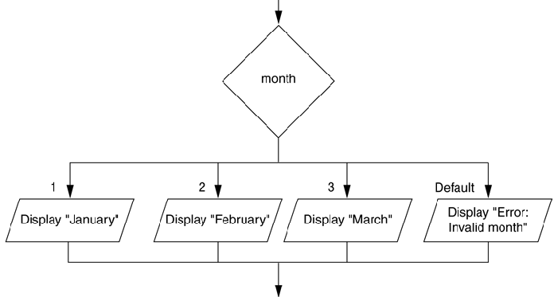
The Case Structure
The case structure lets the value of a variable or an expression determine which path of execution the program will take
Can be used as an alternative to nested decisions
Gaddis, T., Starting Out With Programming Logic and Design, 5 ed, ISBN: 978-0-13-480115-5

Slide 20
The case structure
The case control structure in pseudocode is another way of expressing a linear nested IF statement
Example :
CASE OF tax_code
0 : sales_tax = 0
1 : sales_tax = purch_amt * 0.03
2 : sales_tax = purch_amt * 0.05
3 : sales_tax = purch_amt * 0.07
ENDCASE

Slide 21
Logical Operators
Logical Operators are used between conditions to create complex Boolean expressions
AND – Both conditions must be true
OR – Either condition must be true
NOT – Reverses the truth of an expression
Gaddis, T., Starting Out With Programming Logic and Design, 5 ed, ISBN: 978-0-13-480115-5

Slide 22
Logical Operators
AND example
IF temperature < 20 AND minutes > 12 THEN
DISPLAY “The temperature is in the danger zone.”
ENDIF
OR example
IF temperature < 20 OR temperature > 100 THEN
DISPLAY “The temperature is in the danger zone.”
ENDIF
NOT example
IF NOT (temperature > 100) THEN
DISPLAY “This is below the maximum temperature.”
ENDIF
Gaddis, T., Starting Out With Programming Logic and Design, 5 ed, ISBN: 978-0-13-480115-5

Slide 23
Logical Operators
Range Checking
Often used for range checking
When checking for a number inside a range, use AND
IF x >=20 AND x <=40 THEN
DISPLAY “The value is in the acceptable range.”
ENDIF
When checking for a number outside a range, use OR
IF x < 20 OR x >40 THEN
DISPLAY “The value is outside the acceptable range.”
ENDIF
Gaddis, T., Starting Out With Programming Logic and Design, 5 ed, ISBN: 978-0-13-480115-5

Slide 24
Boolean Variables
A variable of the Boolean data type can hold one or two values: true or false
Declare Boolean isLunchTime
IF time >=12 THEN
SET isLunchTime = True
ELSE
SET isLunchTime = False
ENDIF
Gaddis, T., Starting Out With Programming Logic and Design, 5 ed, ISBN: 978-0-13-480115-5

Slide 25
References
Gaddis, T. (2019). Starting Out with Programming Logic and Design 5th. ISBN: 978-0-13-480115-5

